Slide 1
LLM Hands-on Session
Mohannad Elhamod – IS883

Slide 2
Using LLM APIs

Slide 3
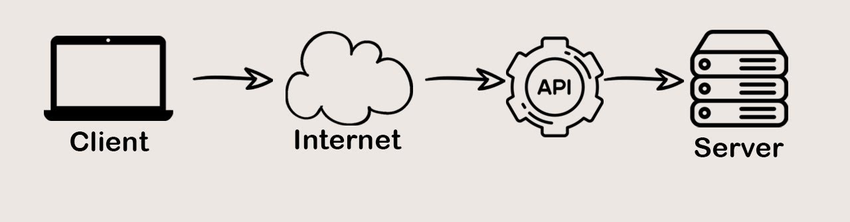
What is an API?
An Application Programming Interface (API) establishes a “contract” or “glue” that allows multiple pieces of software to communicate.
Standardizes software development.
Allows integration with online services.
Is generally well-documented.
CodeWithMazn

Slide 4




LLM APIs
APIs that provide access to LLMs:
You send a query/request (e.g., a prompt or a sentence)
You get a response (e.g., a summary or a translation)

Slide 5
Why LLM APIs (vs. in-house)?
Pros?
Less memory and compute resources needed.
Abstraction in terms of maintenance and updates.
Security?
Cons?
Less control.
Maybe slower.
Cost.
Privacy.

Slide 6
OpenAI API
Documentation
Playground
Guide (notebook)
Pricing
Notes:
- Talk about endpoints
- Talk about different models (size, cost, etc.)

Slide 7
Fine-tuning

Slide 8
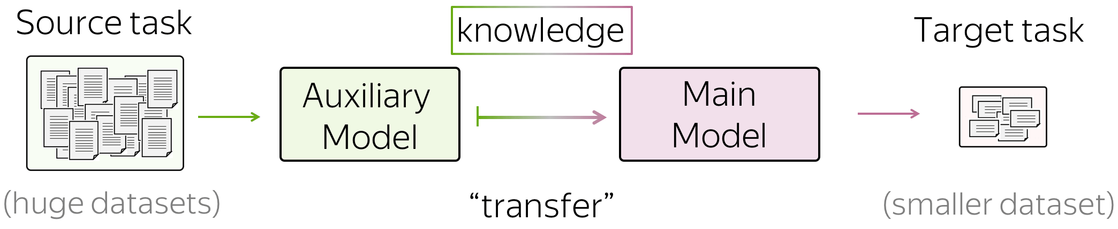
What is Fine-tuning?
Given a pre-trained mode A trained on dataset_1 , one can fine-tune the model to work on a similar dataset_2.
Lena-voita

Slide 9
What is Fine-tuning?
Saves on training time.
Saves on cost and resources.
Improves results.
Lena-voita

Slide 10
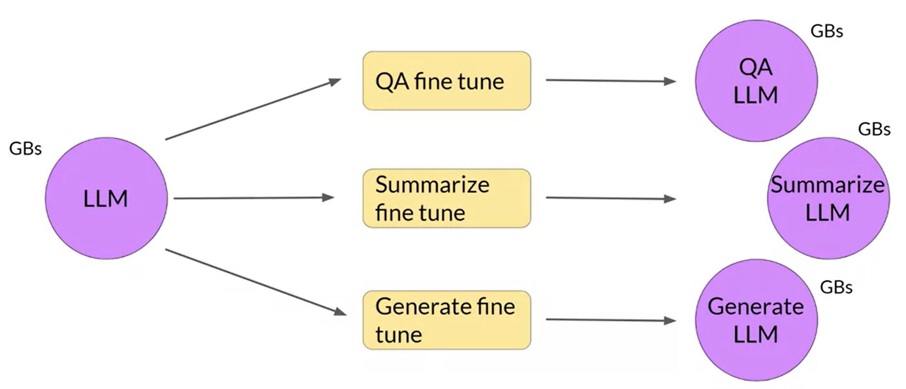
Transfer learning
You can learn a model on Task A and “transfer” that knowledge to Task B using fine-tuning.
Coursera

Slide 11
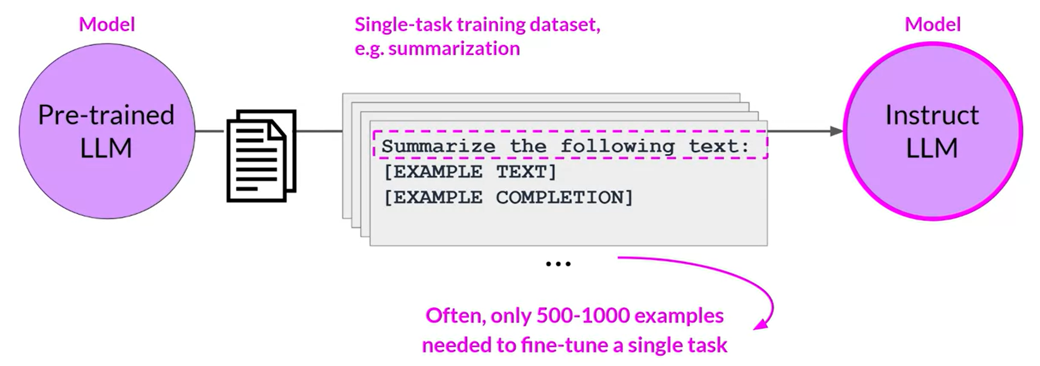
Transfer learning
You can learn a model on Task A and “transfer” that knowledge to Task B using fine-tuning.
Coursera

Slide 12
Demo
Using a language model for Yelp reviews

Slide 13
Code Development Tools

Slide 14

GitHub
Widely used.
Helps with team collaborations.
Tracks code change history.
Can automate tasks such as deployment.
Allows multiple versions of the code (e.g., for different features).

Slide 15

VS Code
A powerful editor by Microsoft
Lightweight and easy to use.
Can integrate with GitHub.
Helpful features: IntelliSense.

Slide 16
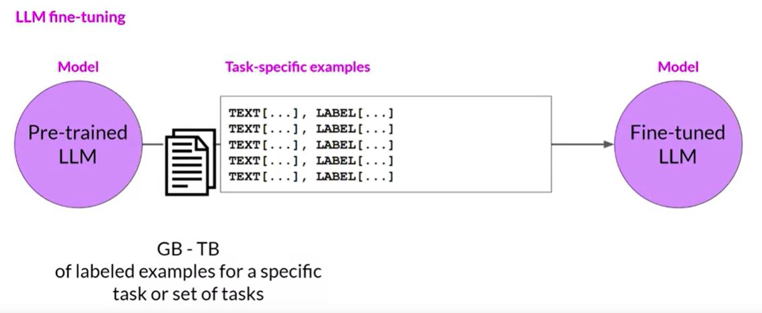
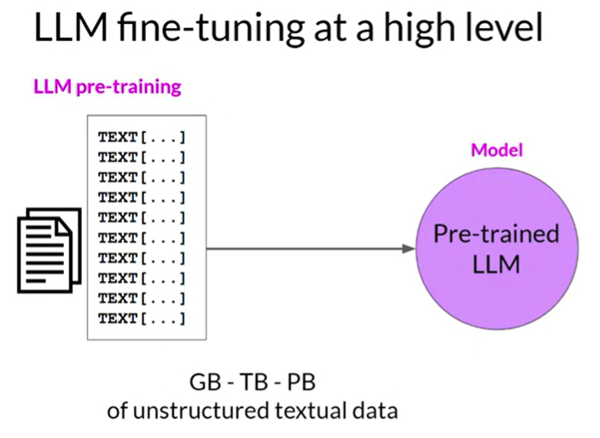
Notes:
https://www.coursera.org/learn/generative-ai-with-llms/lecture/exyNC/instruction-fine-tuning

Slide 17
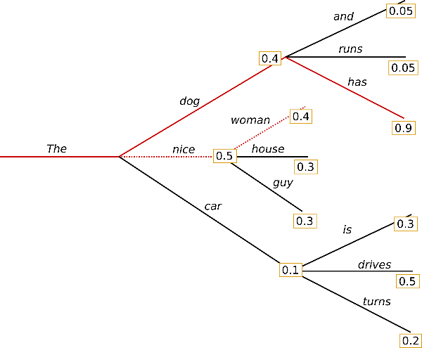
Notes:
https://colab.research.google.com/github/huggingface/blog/blob/main/notebooks/02_how_to_generate.ipynb#scrollTo=5ClO3VphqGp6 top k top p beam…etc

